Slide 1


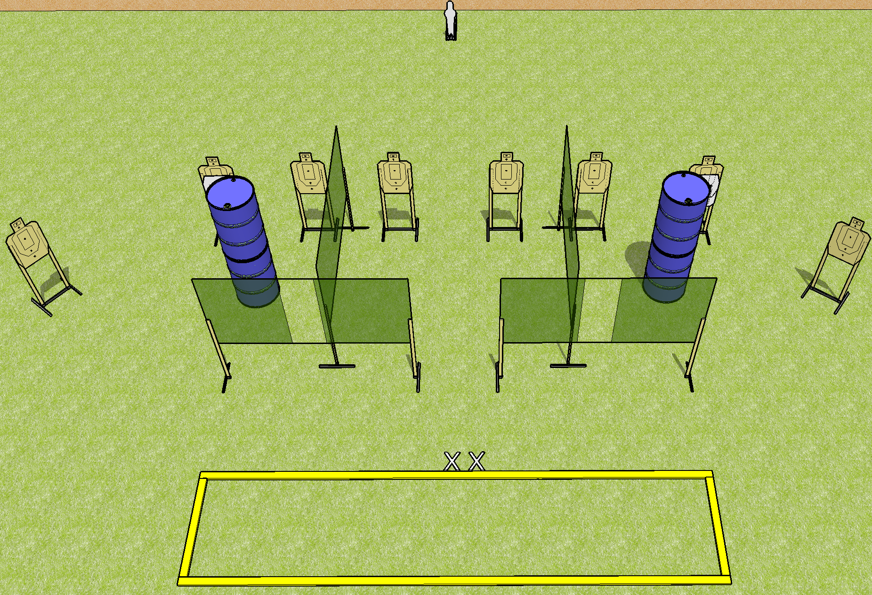
 | Dothan Gun Club – USPSA Match Burner Course Designer : Drew Coleman Bay: 6
Round Count 25 rounds 8 USPSA 1 mini popper
Equipment List 8 wall feet 10 targets (8 + 2 NS)

Slide 2
Burner
Written Stage Briefing
Scoring: Comstock Rounds: 25
Targets: 8 USPSA, 1 steel
Best 3 per target
Handgun start position: completely outside the shooting area, heels on X’s, wrists below belt. Handgun is loaded and holstered.
PCC start position: completely outside the shooting area, heels on X’s, stock on belt. Loaded carbine is held with both hands, safety on.
Stage Procedure: on the audible start signal, engage targets as they become available from within the shooting area.

